Slide 1
CS 4215: Quantitative Performance Evaluation for Computing Systems
Lydia Y. Chen
y.chen-10@tudelft.nl

Slide 2
Motivation

Slide 3
From measurement to modeling

Slide 4
Course Overivew

Slide 5
Overview - schedule
Overview on quantitative methods and basics mathematics tools. (week 1)
Queueing methods for modeling computing systems (week 1 and 2)
Scheduling and load balancing (week 3 )
Machine learning methods for modeling computing systems (week 4 )
Design of experiments and simulation (week 5)
System security and scalability analysis (week 6)
Optimization and resource management (week 7)

Slide 6
Overview – assessment
Homework (50%): 2 individual homework due in week 4 and 7. Each homework accounts 25% of the grade and cover 3 weeks material. Homework will be given in week 1 and 4. Students have three weeks time to complete them.
Group project (50%): group project report (40%) and presentation (10%). There will be 7 predefined projects students can choose from. There will be an interim discussion with each team in week 6. The final report will be due in week 9, and 20 minutes presentation in week 9 as well.

Slide 7
Performance Evaluation Overview

Slide 8
Key metrics
Performance metrics:
Average (tail) response times
Maximum throughput
Availability (failure rate)
Scalability ()
Workload metrics
Arrival rates
Service demands

Slide 9
Architecture of computer systems
Multiple -level programming
Network protocol

Slide 10
Operational Laws & Modification Analysis

Slide 11
Operational laws
Utilization Law
Forced Flow Law
Little’s Law
General Response Time Law
Interactive Response Time Law
Bottleneck Law

Slide 12
Operational Laws
Relationships that do not require any assumptions about the distribution of service times or inter-arrival times.
Operational ⇒ Directly measured.
Operationally testable assumptions ⇒ assumptions that can be verified by measurements.
For example, whether number of arrivals is equal to the number of completions?
This assumption, called job flow balance, is operationally testable.
A set of observed service times is or is not a sequence of independent random variables is not is not operationally testable.

Slide 13
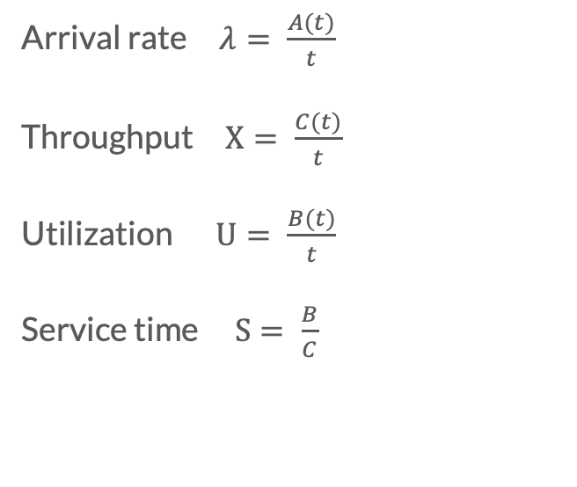
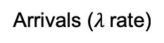
Terminologies
Quantities that can be directly measured during a finite observation period.
t = Observation interval
A_{i} = number of arrivals
C_{i} = number of completions
B_{i} = busy time B_{i}
Arrivals ($λ$rate)
Any system
Departures
Arrival rate $λ= \frac{A(t)}{t}$
Throughput $X= \frac{C(t)}{t}$
Utilization $U= \frac{B(t)}{t}$
Service time $S= \frac{B}{C}$
Time in system, T

Slide 14
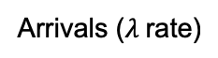
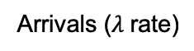
Open v.s. Closed systems
Open systems
External arrivals
Eg., web serve requests
.
Closed systems
Fix number of clients
Eg., thread pool
Arrivals ($λ$rate)
Any system
Departures
Arrivals ($λ$rate)
Any system
Departures

Slide 15
The average number of jobs in the system =
(the average arrival rate) X
(the average time a job spends in the systems)

Slide 16
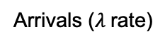
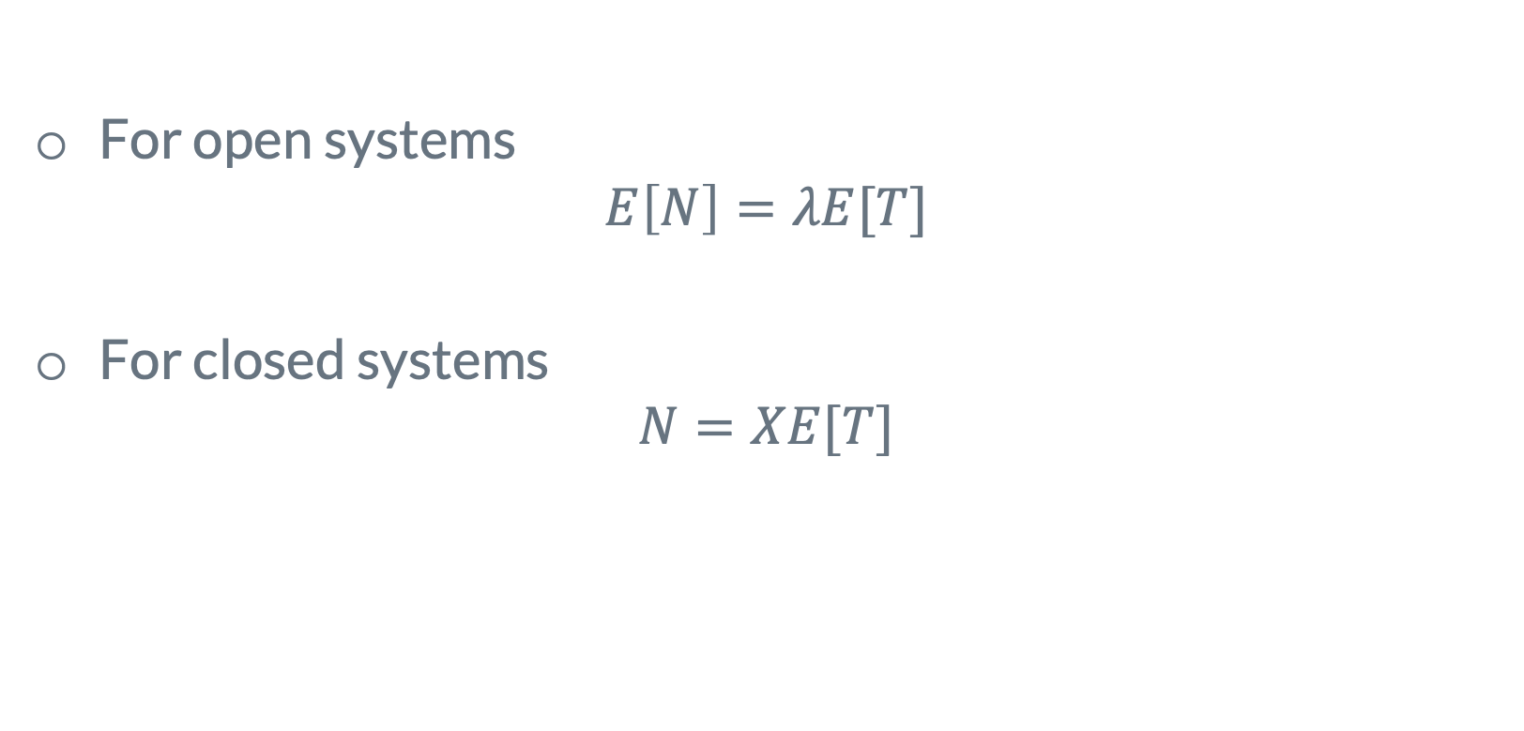
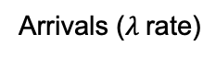
Little's Laws
For open systems
$$E\left[N\right]=λE[T]$$
For closed systems
$$N=XE[T]$$
Arrivals ($λ$rate)
Any system
Departures
Arrivals ($λ$rate)
Any system
Departures

Slide 17
Little's Law for open systems: proof sketch
Ti: time of ith job spend int the system
C(t): number of job completion till time t
A(t): number of job arrivals till time t

Slide 18
Proof sketch for Little’s Law

Slide 19
Little's Laws
Q. Are we assuming FCFS service order?
For open systems
$$E\left[N\right]=λE[T]$$
For closed systems
$$N=XE[T]$$
Q. Can the system have multiple servers
Question: if we are are only interested in “red” type of jobs, can we apply little’s law?

Slide 20
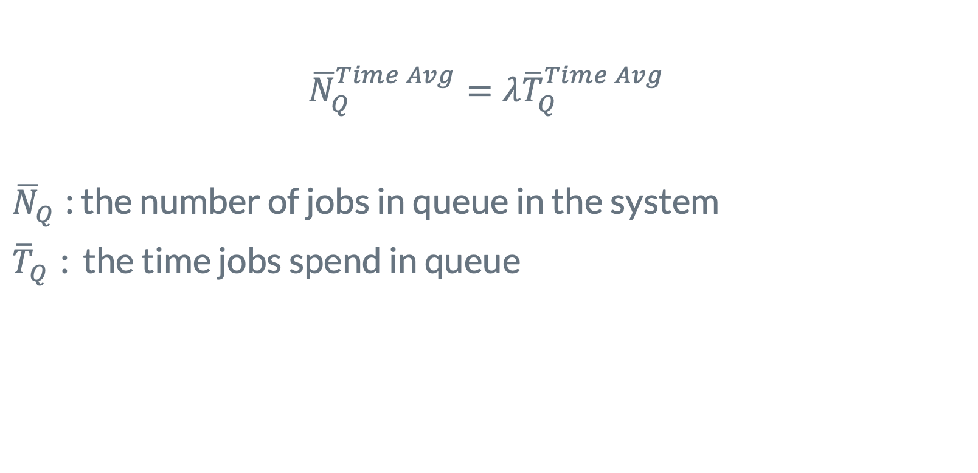
Little's Laws for Time in Queue
$${\overline{N}}_{Q}^{Time Avg}=λ{\overline{T}}_{Q}^{Time Avg}$$
${\overline{N}}_{Q}^{}$: the number of jobs in queue in the system
${\overline{T}}_{Q}^{}$: the time jobs spend in queue
Q. How to prove it?

Slide 21

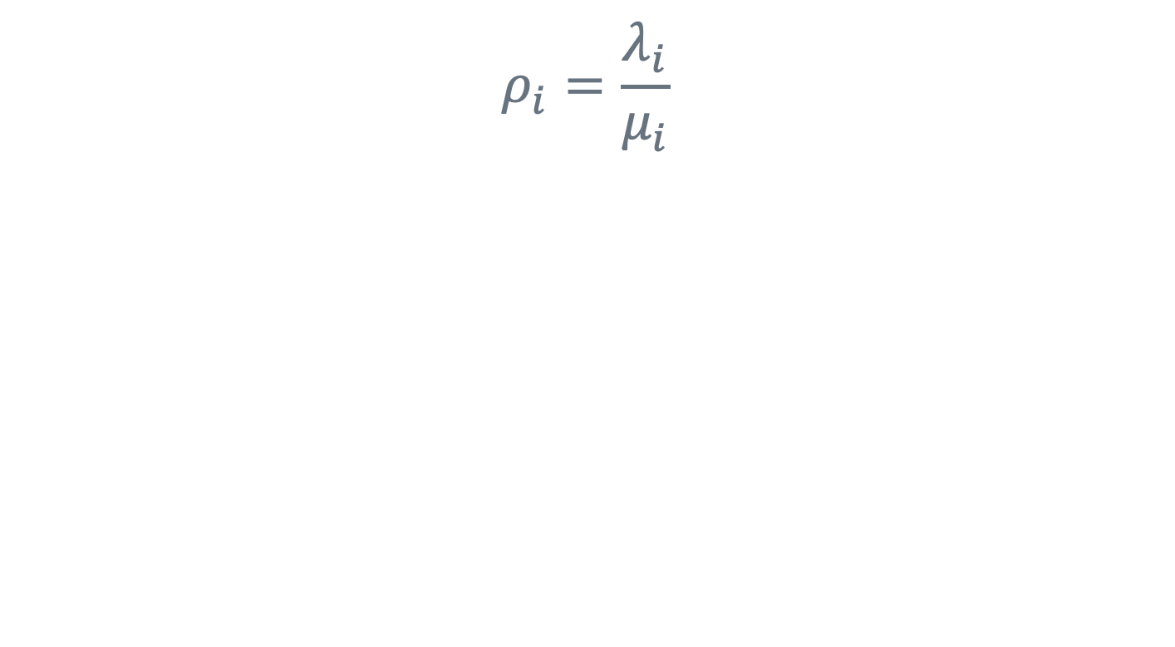
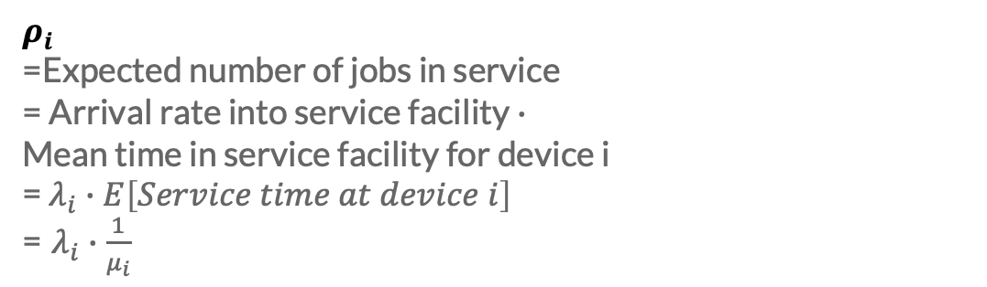
Utilization Law
$$ρ_{i}=\frac{λ_{i}}{μ_{i}}$$
Q. How to prove it?
$$ρ_{i}$$
=Expected number of jobs in service
= Arrival rate into service facility $∙$
Mean time in service facility for device i
= $λ_{i}∙E\left[Service time at device i\right]$
= $λ_{i}∙\frac{1}{μ_{i}}$
Hint: let the system consist of just the service facility without the associated queue
λ
μ
Arrival rate,

Slide 22

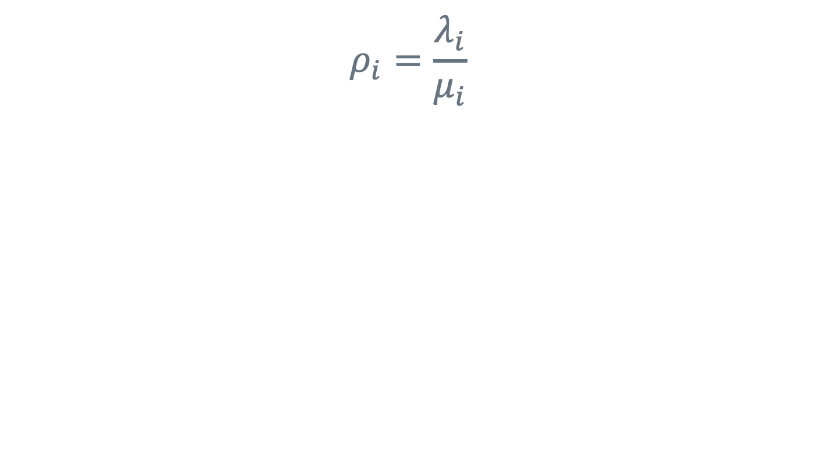
Utilization Law
$$ρ_{i}=\frac{λ_{i}}{μ_{i}}$$
$${ ρ}_{i}=λ_{i}E\left[S_{i}\right]=λ_{i}E\left[S_{i}\right]$$

Slide 23
Example 1
Interactive systems with N=10 users, shown below. The expected think time is E[Z]=5 seconds and that the expected response time is E[R]=15 seconds, measuring from in to out.
Q. What is the throughput?

Slide 24
Example 2
A single FCFS queue with a capacity limit of 7 jobs. Arrivals that find a full buffer are dropped?
Q. What does Littles Law look like for this systems

Slide 25

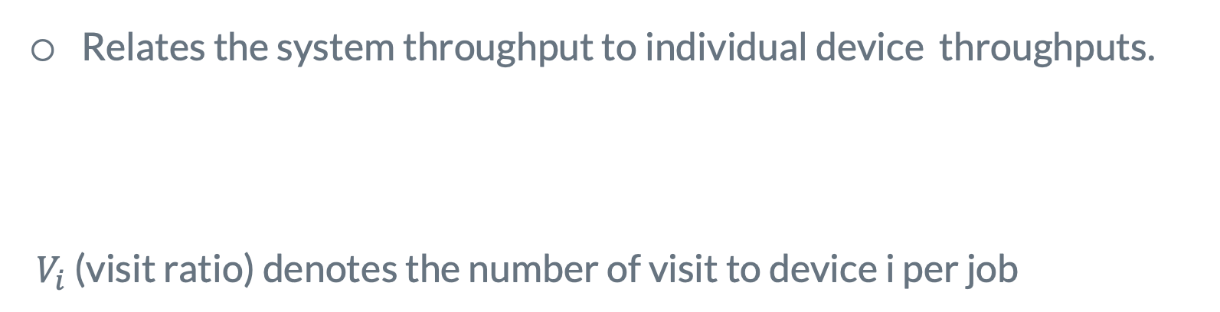
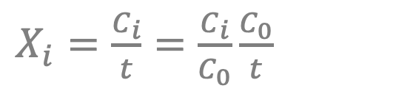
Forced Flow Law
Relates the system throughput to individual device throughputs.
$V_{i}$ (visit ratio) denotes the number of visit to device i per job
$${ X}_{i}=E\left[V_{i}\right]∙X$$
Q. Intuitively make sense?
Device i
$X_{i}=\frac{C_{i}}{t}=$ $\frac{C_{i}}{C_{0}}\frac{C_{0}}{t}$
In
Jobs
Out

Slide 26
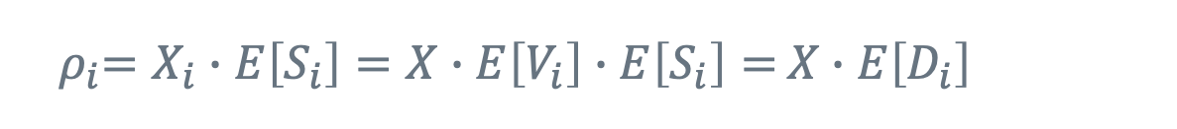

Bottleneck Law
$${ ρ}_{i}=X∙E\left[D_{i}\right]$$
D_{i}=V_{i} S_{i} is the total service demand on the device for all visits of a job.
Proof: by combining the forced flow law and the utilization law, we get:
The device with the highest D_{i} has the highest utilization and is the bottleneck device.
${ ρ}_{i}=X_{i}∙E\left[S_{i}\right]=X∙E\left[V_{i}\right]∙E\left[S_{i}\right]=$ $X∙E\left[D_{i}\right]$

Slide 27
Bottleneck analysis
Improving the bottleneck device will provide the highest payoff in terms of system throughput.
Improving other devices will have little effect on the system performance.
Identifying the bottleneck device should be the first step in any performance improvement project.

Slide 28


In-class exercise
An interactive system with following characteristics
25 terminals (N=25)
18 seconds average think time
20 visits to a specific SSD per interaction on average
30 % utilization of that SSD
0.025 seconds average service time per visit to that disk
Question: what is the mean response time
$${ E[R]}_{}=\frac{N}{X}∙E\left[Z\right]$$
$${ X}_{}=\frac{X_{disk}}{{E[V}_{disk}]}=\frac{\frac{ρ_{disk}}{E[S_{disk}]}}{{E[V}_{disk}]}$$

Slide 29
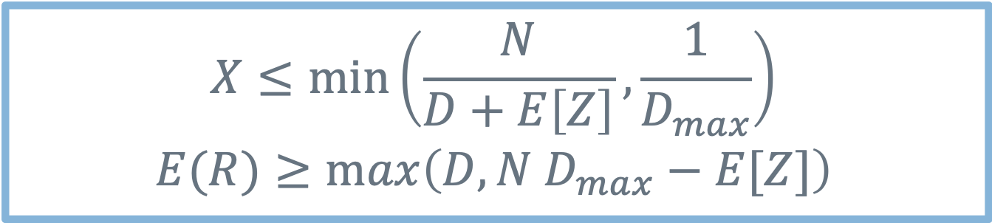
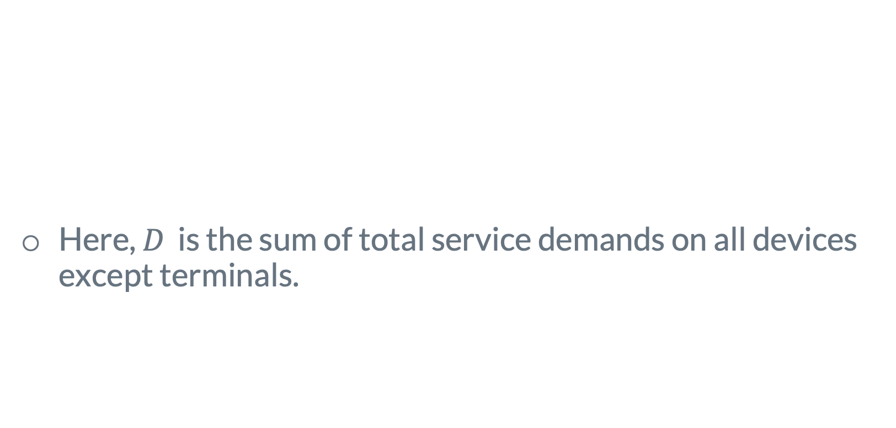
Asymptotic bounds for closed systems
Intuitive meaning?
Here, $D$ is the sum of total service demands on all devices except terminals.
$$X≤\min_{}\left(\frac{N}{D+E\left[Z\right]},\frac{1}{D_{max}}\right)$$
$$E(R)≥\max_{}\left(D, N D_{max}−E[Z]\right)$$

Slide 30
Proof for asymptotic bounds
The asymptotic bounds are based on the following observations:
The utilization of any device cannot exceed one. This puts a limit on the maximum obtainable throughput.
The response time of the system with N users cannot be less than a system with just one user. This puts a limit on the minimum response time.

Slide 31


Proof (Cont)
The interactive response time formula can be used to convert the bound on throughput to that on response time and vice versa.
For the bottleneck device b we have:
Since U_{b} cannot be more than one, we have:
$${ U}_{b}=X∙D_{max}$$
$${ U}_{b}=X∙D_{max}≤1$$
$$X≤\frac{1}{D_{max}}$$

Slide 32
Proof (Cont)
With just one job in the system, there is no queueing and the system response time is simply the sum of the service demands:
Here, D is defined as the sum of all service demands.
With more than one user there may be some queueing and so the response time will be higher. That is:

Slide 33
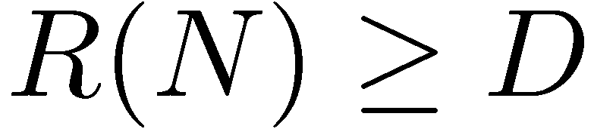
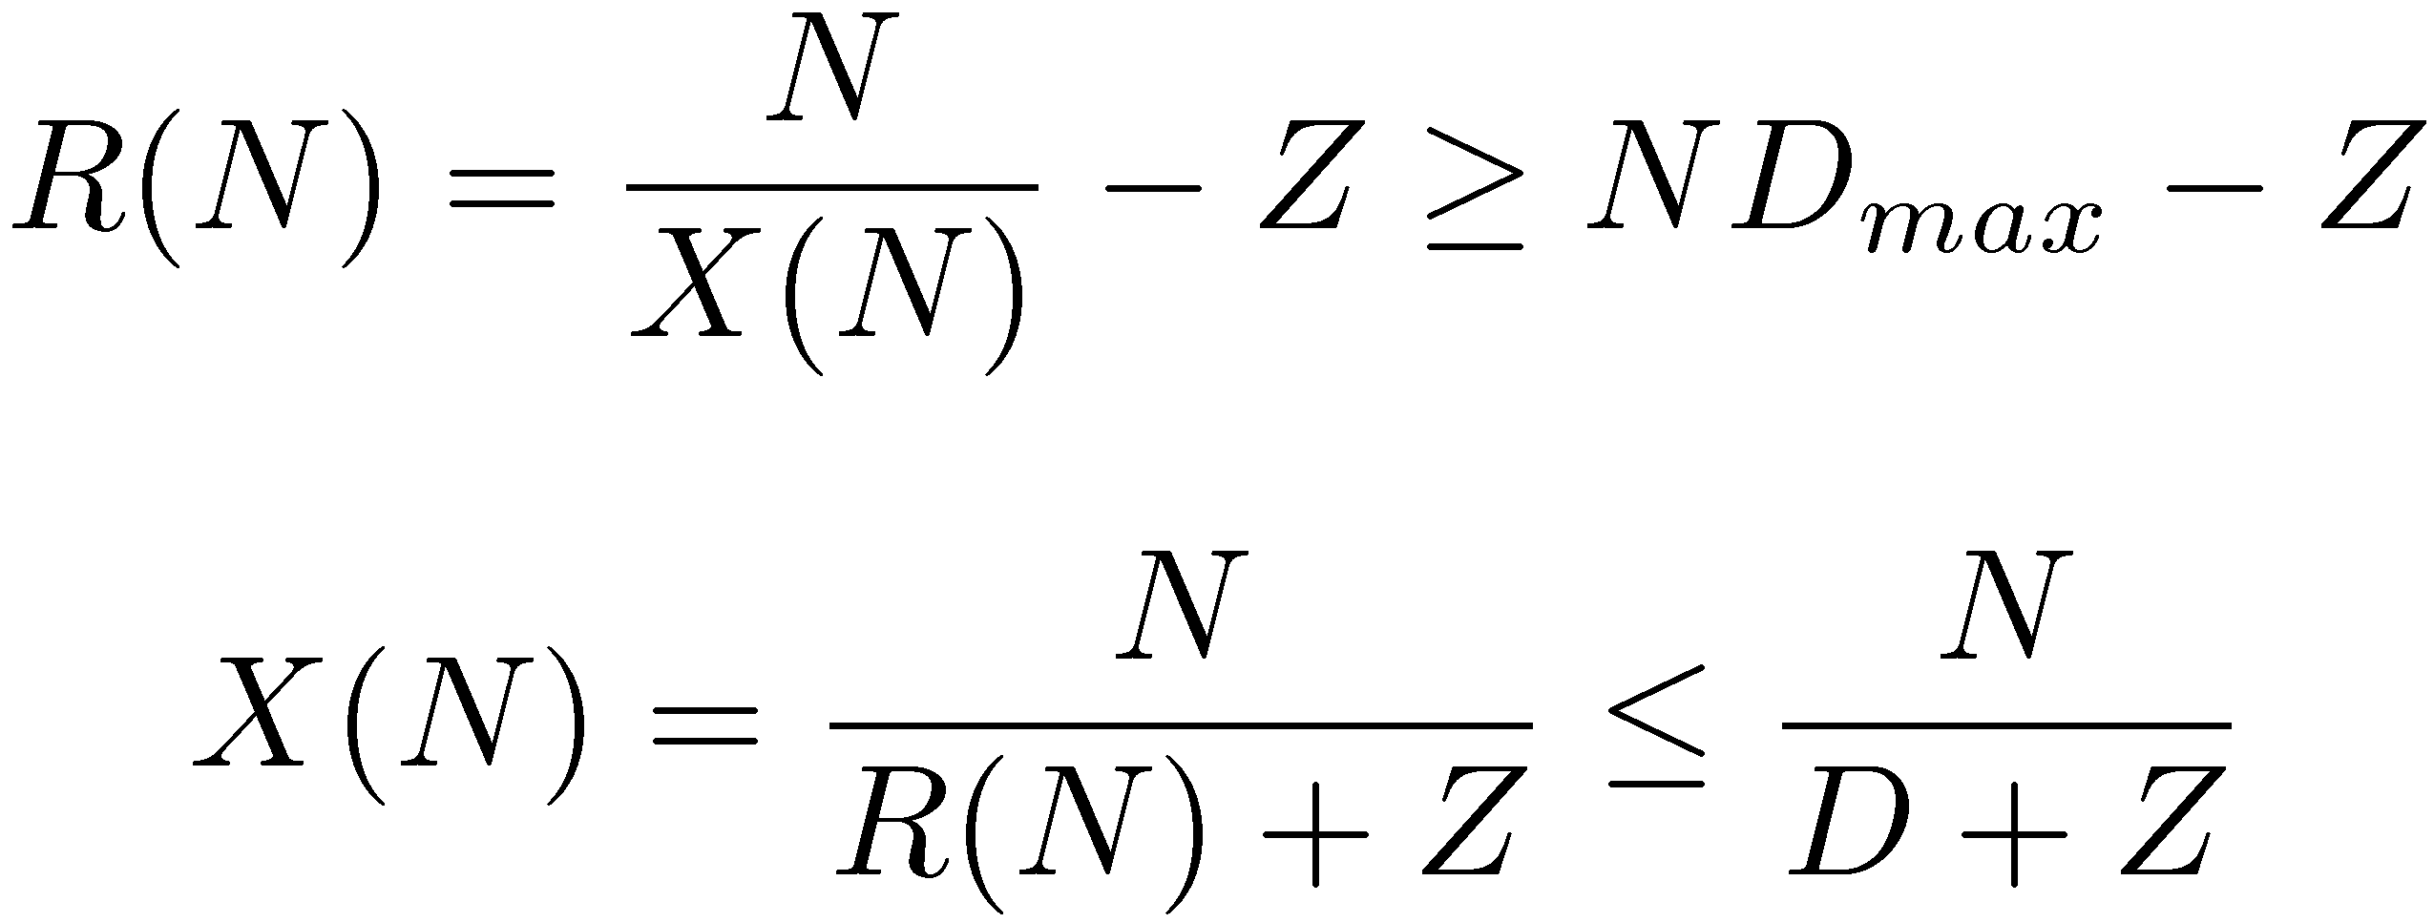
Proof (Cont)
Applying the interactive response time law to the bounds:
Combining these bounds we get the asymptotic bounds.

Slide 34
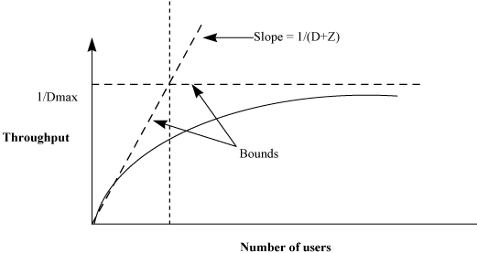
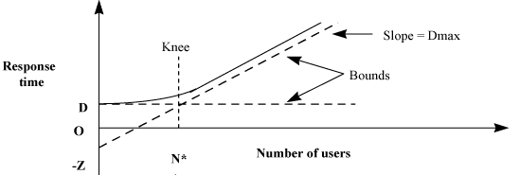
Typical Asymptotic Bounds

Slide 35
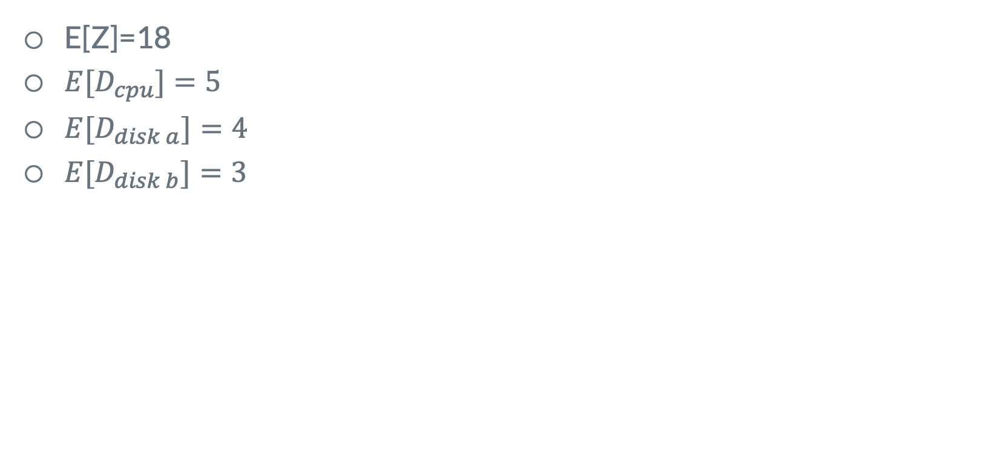
Asymptotic example
E[Z]=18
${E[D}_{cpu}]=5$
${E[D}_{disk a}]=4$
${E[D}_{disk b}]=3$

Slide 36
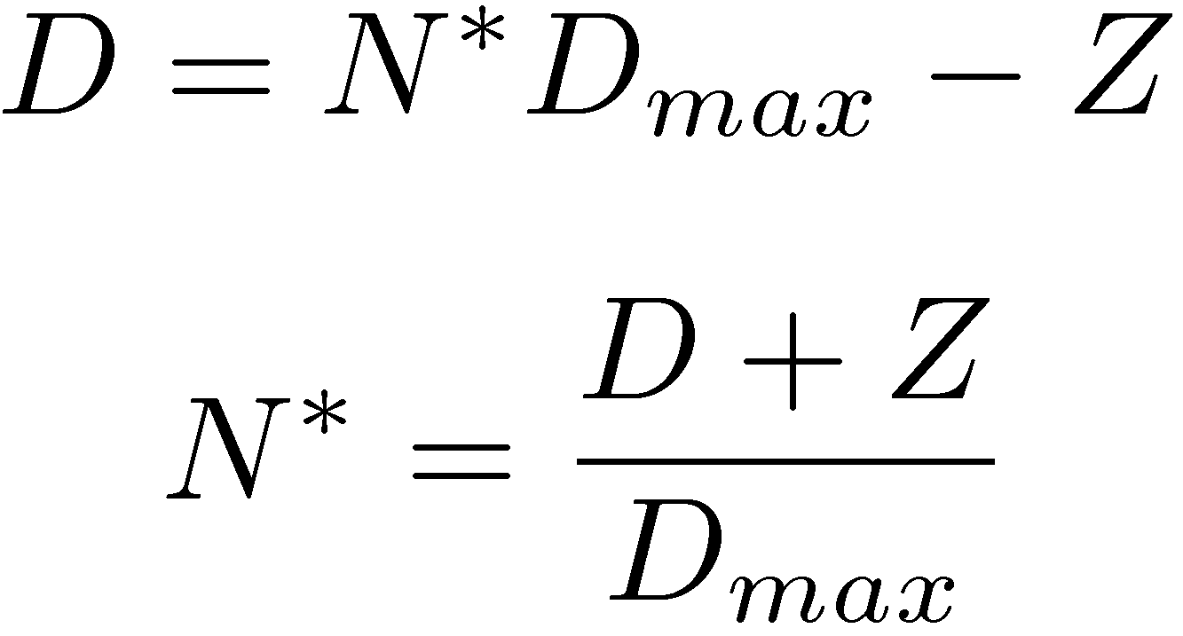
Typical Asymptotic Bounds (Cont)
The number of jobs N* at the knee is given by:
If the number of jobs is more than N*, then we can say with certainty that there is queueing somewhere in the system.
The asymptotic bounds can be easily explained to people who do not have any background in queueing theory or performance analysis.

Slide 37
Question
How much does the throughput improve from (a) to (b)? How about the response time?
No Change! Why?
Bottleneck remains

Slide 38
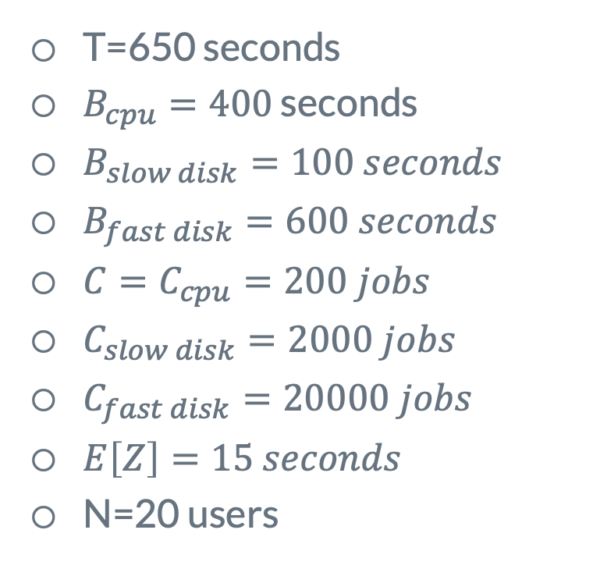
More on modification analysis
T=650 seconds
$B_{cpu}=400$ seconds
$B_{slow disk}=100 seconds$
$B_{fast disk}=600 seconds$
${C=C}_{cpu}=200 jobs$
$C_{slow disk}=2000 jobs$
$C_{fast disk}=20000 jobs$
$E\left[Z\right]=15 seconds$
N=20 users
Faster CPU?
Replace it with twice faster one
Balancing slow and fast disks?
Second fast disk?

Slide 39
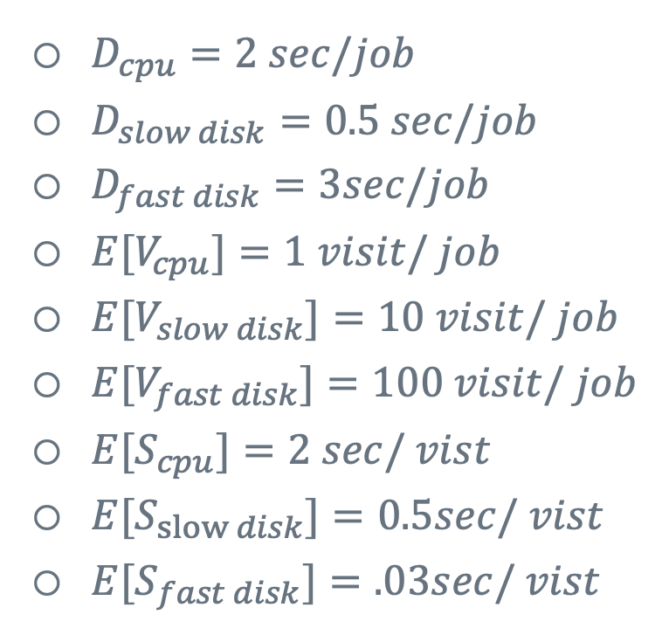
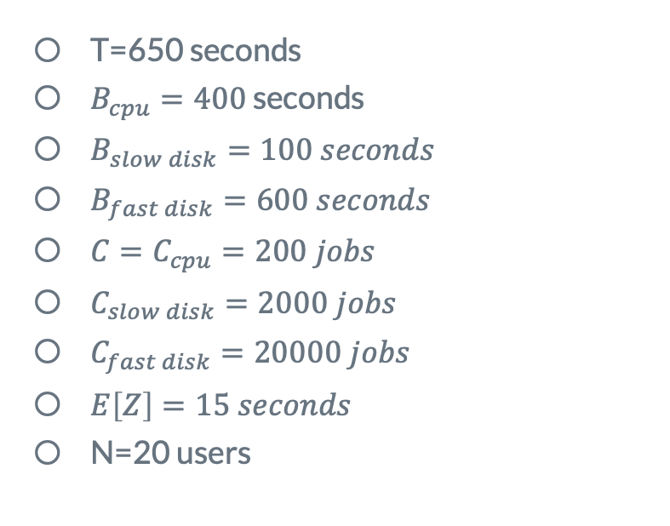
More on modification analysis
Faster CPU?
Replace it with twice faster one
T=650 seconds
$B_{cpu}=400$ seconds
$B_{slow disk}=100 seconds$
$B_{fast disk}=600 seconds$
${C=C}_{cpu}=200 jobs$
$C_{slow disk}=2000 jobs$
$C_{fast disk}=20000 jobs$
$E\left[Z\right]=15 seconds$
N=20 users
$D_{cpu}=2 sec/job$
$D_{slow disk}=0.5 sec/job$
$D_{fast disk}=3sec/job$
${E[V}_{cpu}]=1 visit/ job$
${E[V}_{slow disk}]=10 visit/ job$
${E[V}_{fast disk}]=100 visit/ job$
${E[S}_{cpu}]=2 sec/ vist$
${E[S}_{slow disk}]=0.5sec/ vist$
${E[S}_{fast disk}]=.03sec/ vist$

Slide 40
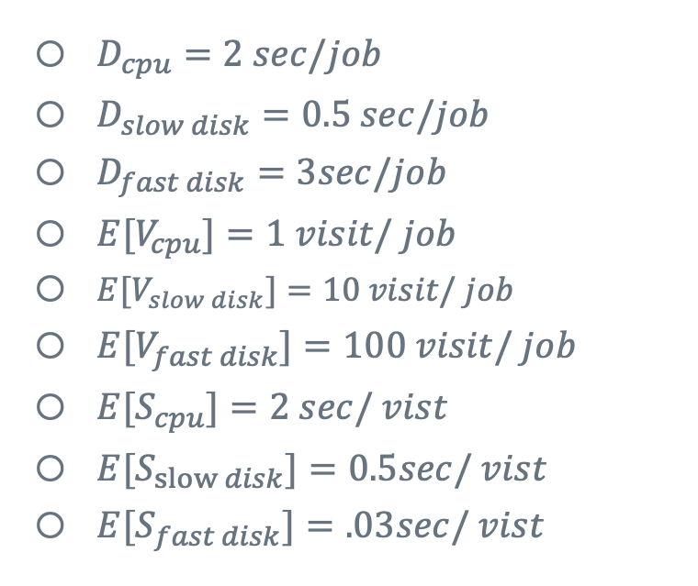
More on modification analysis
T=650 seconds
$B_{cpu}=400$ seconds
$B_{slow disk}=100 seconds$
$B_{fast disk}=600 seconds$
${C=C}_{cpu}=200 jobs$
$C_{slow disk}=2000 jobs$
$C_{fast disk}=20000 jobs$
$E\left[Z\right]=15 seconds$
N=20 users
$D_{cpu}=2 sec/job$
$D_{slow disk}=0.5 sec/job$
$D_{fast disk}=3sec/job$
${E[V}_{cpu}]=1 visit/ job$
${E[V}_{slow disk}]=10 visit/ job$
${E[V}_{fast disk}]=100 visit/ job$
${E[S}_{cpu}]=2 sec/ vist$
${E[S}_{slow disk}]=0.5sec/ vist$
${E[S}_{fast disk}]=.03sec/ vist$
Faster CPU?
Replace it with twice faster one

Slide 41
More on modification analysis
Balancing slow and fast disks?
T=650 seconds
$B_{cpu}=400$ seconds
$B_{slow disk}=100 seconds$
$B_{fast disk}=600 seconds$
${C=C}_{cpu}=200 jobs$
$C_{slow disk}=2000 jobs$
$C_{fast disk}=20000 jobs$
$E\left[Z\right]=15 seconds$
N=20 users
$D_{cpu}=2 sec/job$
$D_{slow disk}=0.5 sec/job$
$D_{fast disk}=3sec/job$
${E[V}_{cpu}]=1 visit/ job$
${E[V}_{slow disk}]=10 visit/ job$
${E[V}_{fast disk}]=100 visit/ job$
${E[S}_{cpu}]=2 sec/ vist$
${E[S}_{slow disk}]=0.5sec/ vist$
${E[S}_{fast disk}]=.03sec/ vist$

Slide 42
More on modification analysis
Second fast disk?
T=650 seconds
$B_{cpu}=400$ seconds
$B_{slow disk}=100 seconds$
$B_{fast disk}=600 seconds$
${C=C}_{cpu}=200 jobs$
$C_{slow disk}=2000 jobs$
$C_{fast disk}=20000 jobs$
$E\left[Z\right]=15 seconds$
N=20 users
$D_{cpu}=2 sec/job$
$D_{slow disk}=0.5 sec/job$
$D_{fast disk}=3sec/job$
${E[V}_{cpu}]=1 visit/ job$
${E[V}_{slow disk}]=10 visit/ job$
${E[V}_{fast disk}]=100 visit/ job$
${E[S}_{cpu}]=2 sec/ vist$
${E[S}_{slow disk}]=0.5sec/ vist$
${E[S}_{fast disk}]=.03sec/ vist$

Slide 43
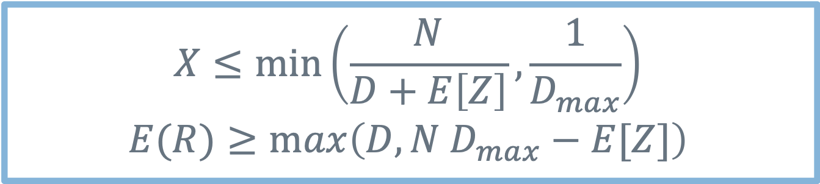



Summary
E$\left[N\right]=λE[T]$
Little’s Law
Utilization Law
Forced Flow Law
Asymptotic bounds
$${ ρ}_{i}=X∙E\left[D_{i}\right]$$
$${ X}_{i}=E\left[V_{i}\right]∙X$$
$$X≤\min_{}\left(\frac{N}{D+E\left[Z\right]},\frac{1}{D_{max}}\right)$$
$$E(R)≥\max_{}\left(D, N D_{max}−E[Z]\right)$$

Slide 44
Bonus quiz

Slide 45
Related homework
Exercise 6.4, 7.4

Slide 46
Next lecture:

Slide 47
Thanks!
Any questions?
y.chen-10@tudelf.nl
lydiaychen@ieee.org

Slide 48
Presentation design
This presentations uses the following typographies and colors:
Titles: Raleway
Body copy: Lato
You can download the fonts on these pages:
https://www.fontsquirrel.com/fonts/raleway
https://www.fontsquirrel.com/fonts/lato
Dark blue #2185c5
Light blue #7ecefd
Yellow #ff9715
Magenta #f20253
Dark gray #677480
Light gray #97abbc
You don’t need to keep this slide in your presentation. It’s only here to serve you as a design guide if you need to create new slides or download the fonts to edit the presentation in PowerPoint®

Slide 49
SlidesCarnival icons are editable shapes.
This means that you can:
Resize them without losing quality.
Change fill color and opacity.
Change line color, width and style.
Isn’t that nice? :)
Examples:

Slide 50
😉
Now you can use any emoji as an icon!
And of course it resizes without losing quality and you can change the color.
How? Follow Google instructions https://twitter.com/googledocs/status/730087240156643328
✋👆👉👍👤👦👧👨👩👪💃🏃💑❤😂😉😋😒😭👶😸🐟🍒🍔💣📌📖🔨🎃🎈🎨🏈🏰🌏🔌🔑 and many more...

